Slide 1


Royal Arch Research Assistance
The General Grand Chapter
Royal Arch Masons International
2021 Program Presentation

Slide 2
History of
Royal Arch Research Assistance
At the 1972 Triennial meeting in Las Vegas, M.E. Edward Selby, General Grand King, GGCRAMI, proposed that General Grand Chapter have a unique philanthropy – one that would not duplicate existing charities. The plans were implemented in 1975 during M.E. Gordon Merrick’s term.
Royal Arch Research Assistance was born.

Slide 3
Mission of
Royal Arch Research Assistance
The mission of the Royal Arch Research Assistance has been to help children with Central Auditory Processing Disorders (CAPD) by funding research.
In the beginning R.A.R.A. funded research by Dr. Jack Williford followed by Dr. Joan Burleigh of Colorado State University who later formed the Able Kids Foundation until they discontinued their research program.
Funding was then shifted to Dr. Frank Musiek at the University of Connecticut, and later the University of Arizona until his retirement. Autism Speaks and the Hearing Health Foundation were also added to our program at that time.

Slide 4
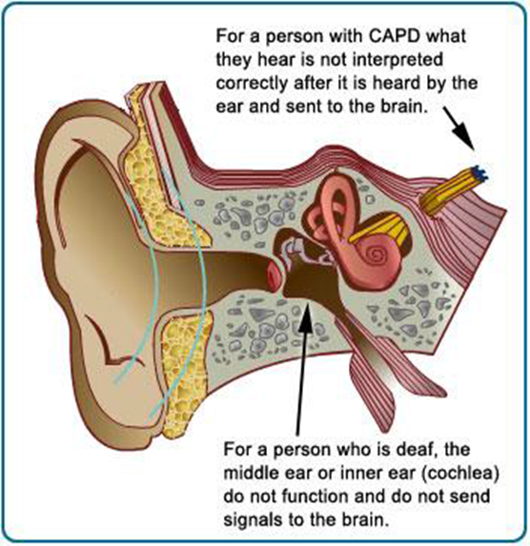
What exactly is
Central Auditory Processing Disorders(CAPD)
Sound waves from our environment travel into our ears where they’re converted to vibrations in the middle ear.
When vibrations reach the inner ear, various sensory cells create an electrical signal that travels via the auditory nerve to the brain. In the brain, this signal is analyzed and processed to turn it into a sound that you can recognize.
People with CAPD have a problem with this processing step. Because of this, they have trouble understanding and responding to sounds in their environment.

Slide 5

What is it like to live with a weak Auditory System?
Think about listening to the radio in your car and suddenly more than one station is playing at one time. You can’t decipher which song to listen to or which DJ to listen to.

Slide 6

What is it like to live with a weak Auditory System?
That is how a student with a weak auditory processing system is challenged every day. They try to take in information from their teacher while the lights hum, the lockers slam, other students talk, the lawnmower outside runs, students move about in the hallway, you get the picture.
Here is what having CAPD is like to one young lady:
https://www.youtube.com/watch?v=P5-V18iHr1I

Slide 7

What does a parent of a CAPD child want you to know?
He isn’t being defiant – the brain doesn’t always process spoken words smoothly.
The link between CAPD (aka APD) and hearing can be confusing. It isn’t the same as being hard of hearing, the CAPD child hears very well. In fact, they hear too good. They hear sounds no one else at home or in the class hears.

Slide 8
What to look for:
difficulty understanding speech, particularly in noisy environments or when more than one person is speaking
frequently asking people to repeat what they’ve said or responding with words like “huh” or “what”
misunderstanding what’s been said

Slide 9
What to look for:
needing a longer response time during conversation
trouble telling where a sound is coming from
problems distinguishing between similar sounds

Slide 10
What to look for:
difficulty concentrating or paying attention
problems following or comprehending rapid speech or complex directions
trouble with learning or enjoying music

Slide 11
How is Auditory Processing Disorder diagnosed?
There’s no standard process for diagnosing APD. The first part of the process involves taking a thorough history.
This can include evaluating your symptoms and when they started as well as checking to figure out if you have any risk factors for APD.

Slide 12
How is Auditory Processing Disorder diagnosed?
Testing must be done by an Audiologist using specialized equipment.
Here is a short video describing how Cincinnati Children’s Hospital does its’ testing. https://www.youtube.com/watch?v=_mny9WhifUA

Slide 13
Our Current Partners Searching for Answers
Hearing Health Foundation
(HHF)
AUTISM SPEAKS
It’s Time to Listen

Slide 14

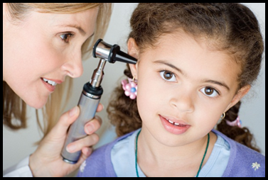
Since 2011, RARA has funded 42 emerging scientists investigating CAPD.
As causes of CAPD are unknown, each researcher has a different area of focus.
Research is conducted on earlier detection and better treatments of CAPD.

Slide 15
After a rigorous application & review process, each successful awardee receives a research grant for one year. Scientists are required to provide progress reports and research updates.
The CAPD researchers who have been carefully selected are among the best in the nation.

Slide 16
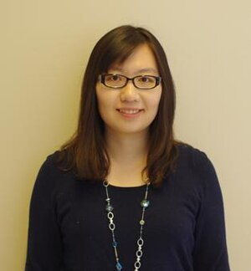
2020 HHF Researcher
Project: Investigating cortical processing during comprehension of reverberant speech in adolescents and young adults with cochlear implants
Through early cochlear implant (CI) fitting, many children diagnosed with profound neurosensorial hearing loss gain access to verbal communications through electrical hearing and go on to develop spoken language. Despite good speech outcomes tested in sound booths, many children experience difficulties in understanding speech in most noisy and reverberant indoor environments. While up to 75 percent of their time learning is spent in classrooms, the difficulty from adverse acoustics adding to children’s processing of degraded speech from CI is not well understood. In this project, we examine speech understanding in classroom-like environments through immersive acoustic virtual reality. In addition to behavioral responses, we measure neural activity using functional near-infrared spectroscopy (fNIRS)—a noninvasive, CI-compatible neuroimaging technique, in cortical regions that are responsible for speech understanding and sustained attention. Our findings will reveal the neural signature of speech processing by CI users, who developed language through electrical hearing, in classroom-like environments with adverse room acoustics.
Z. Ellen Peng, Ph.D.
University of Wisconsin-Madison

Slide 17

AUTISM SPEAKS
It’s Time to Listen
The nation’s leading charity helping children with autism, and probably the most recognized of our Charities …. And
A national charitable partner of the Royal Arch Masons since 2010

Slide 18
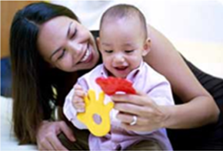
Why Autism Speaks?
85% of children with Autism are later diagnosed with an auditory processing disorder such as CAPD

Slide 19
AUTISM SPEAKS
It’s Time to Listen
Holds Walk-a-thons in more than 80 cities annually. Anyone can participate in the walks.
Start a Walk Now for Autism Speaks team in your city.
“Red Coat” walks.
(Contact your State R. A. R. A. Chairman or State Ambassador)

Slide 20
AUTISM SPEAKS
It’s Time to Listen
The ‘Light-It-Up-Blue’ campaign empowers families and companies to raise awareness in their neighborhoods each year by wearing blue on April 2nd.
Please visit http://www.autismspeaks.org and http://blog.autismspeaks.org
List of Walks http://act.autismspeaks.org/site/PageNavigator/speaks_walk_allevents.html

Slide 21
2021
RESEARCH GRANTS
& DOCTORAL FELLOWSHIP
AUTISM SPEAKS
Bonnie Lau, Ph.D.
Karen Chenausky, Ph.D.
Patrick Dwyer

Slide 22
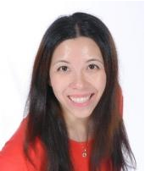
First Grant
Jointly sponsored by R. A. R. A. and Autism Speaks
at the University of Washington will test whether differences in how people integrate sounds from both ears underlies central auditory processing challenges in children with autism. Her work will look at how these processes affect understanding of speech heard in a noisy environment. This research will advance understanding of speech perception in noise as well as the how the brain processes sounds, providing future directions for targeted assessment of auditory processing challenges and new treatments.
Our goal: To help identify how speech processing in both ears relates to understanding speech in noisy environments to target new treatments for auditory processing disorder in children autism.
Bonnie Lau, Ph.D.

Slide 23
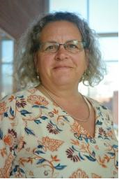
Second Grant
Jointly sponsored by R. A. R. A. and Autism Speaks
at the Massachusetts General Hospital Institute of Health Professions will look at how auditory processing affects the ability to use language for children with autism who have minimal or no spoken language. In addition to other work that suggests auditory processing difficulties are a barrier for autistic children in understanding language, Dr. Chenausky’s study will examine whether those same challenges are linked to barriers in using spoken language. With this knowledge, new speech language therapies may be created to address these challenges and support use of spoken language in minimally verbal children with autism and auditory processing difficulties.
Our goal: To understand whether auditory processing challenges are a barrier to use of spoken language in children with autism with minimal spoken language to guide new treatments for those with auditory processing difficulties and autism.
Karen Chenausky, Ph.D.

Slide 24
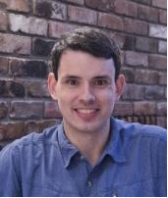
Doctoral Fellowship
Jointly sponsored by R. A. R. A. and Autism Speaks
Predoctoral fellow Patrick Dwyer at the University of California – Davis, under the mentorship of Susan Rivera and Cliff Saron, will investigate the theory of monotropism, which suggests that hyper focus on a particular interest is what draws an autistic person’s attention to certain subjects and not attend to others. In Dwyer’s work, he will look at sensory stimuli in autism, including auditory processing, and its role in attention and sensory responses. The results of this study could have important implications for the treatment or accommodation of sensory processing differences for people with autism.
Patrick Dwyer

Slide 25
How can you help???
Support Royal Arch Research Assistance by giving Annually (or Monthly) in order to continue to do the work that allows the organization to make the effort in understanding and treating individuals with Central Auditory Processing Disorders.
Make your donation today!
Mail donations to:
Your State R. A. R. A. Chairman
or
Royal Arch Research Assistance, LLC
P.O. Box 1040
Bardstown, KY 40004-1040
Donations are tax deductible
Consider including Royal Arch Research Assistance in your estate planning.

Slide 26
Royal Arch Research Assistance -
Recognition Awards for One Time Donations
Certificates are available for contributions of $100, $250 and $500. Certificates are awarded to donating organizations if requested.
A $100 individual contribution receives a Bronze Keystone lapel pin. A $300 contribution receives a Silver Keystone Pin. A $500 contribution receives a Gold Keystone Pin.

Slide 27
Royal Arch Research Assistance
Recognition Awards Cumulative during CURRENT Triennial
A $1000 contribution receives a lapel pin with a diamond in the center.
$2500 contributions receive a Keystone Badge.
$5000 contributions receive a RARA Badge.
$15,000 contributions receive a RARA Royal Arch Award.
$50,000 contributions receive a RARA Ark of the Covenant Award.

Slide 28
Gift for a Gift Music CD
“Gift for a Gift” – Give a one time $500 Donation and receive a Set of 3 Music CD’s for all music in the degrees for all four York Rite Bodies (Lodge, Chapter, Council and Commandery).

Slide 29

ONLINE DONATIONS!!!
Now you can donate online or set up a monthly donation using your credit card.
Go to https://www.ggcrami.org/rara
Royal Arch Research Assistance LLC

Slide 30

Other ways to give
AmazonSmile – You shop. Amazon gives. When you shop at smile.amazon.com, Amazon donates to your favorite charitable organization.
Amazon donates 0.5% of the price of your eligible AmazonSmile purchases to the charitable organization of your choice.
AmazonSmile is the same Amazon you know. Same products, same prices, same service.
Support your charitable organization by starting your shopping at https://smile.amazon.com

Slide 31

Royal Arch Research Assistance
Board Members & Staff
Steven G. Tiner - President
Teko A Foley - First Vice President
Chadwick Burks - Second Vice President William J. Riggs - Board Secretary
Larry E. Gray - Board Treasurer
Paul Chello - Member
Bryce Hildreth - Member
Executive Director
Bob Bean

